Slide 1


OpenShift Sharks
Welcome

Slide 2
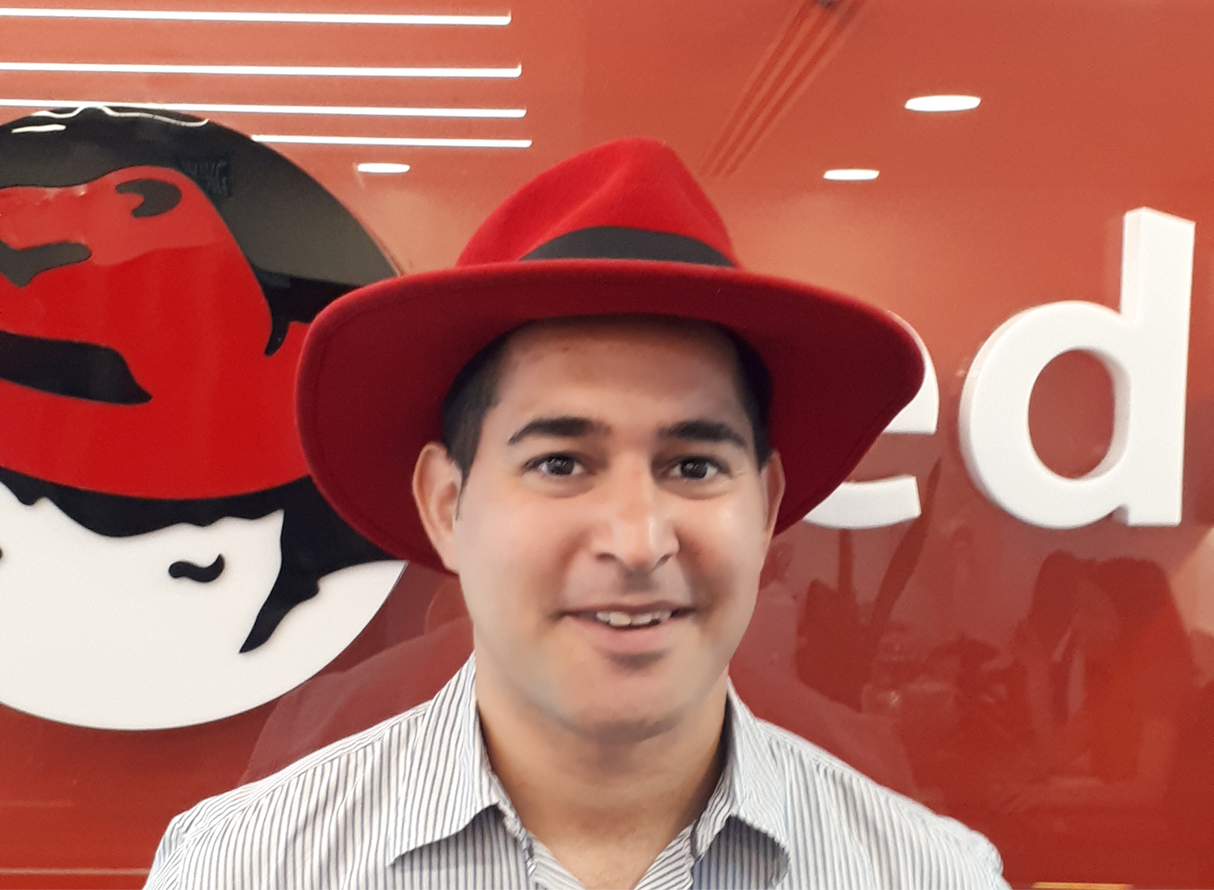


oc whoami
“When Network and DevOps engineers work together there is no problem we can’t solve”
Oren Oichman
Cloud Architect
Red Hat
Ariel Davidov
Devops Engineer
Bank Hapoalim

Slide 3

Workshop rules !!!
Optional section marker or title
The workshop foundation
Baseline !!!
There are NO stupid questions !
Benefit the most from the workshop
Personal Use cases that are more relevant to you
OpenShift Sharks

Slide 4

Why are we here ?
Optional section marker or title
OpenShift Get a deeper understanding on Openshift Networking
IP world understanding cluster networking internally and externally
Wireshark Look at the network flow from the packet P.O.V with wireshark

Slide 5


Gaining Experience In ...
OpenShift networking
Architect complex solution with available OpenShift features
Basic understanding on Wireshark
OpenShift Sharks

Slide 6

Plans for today ...
Going over OpenShift SDN
Advanced OpenShift Networking
Debugging Network Problems with
Wireshark
OpenShift Sharks

Slide 7
Have Fun !!!
Red Hat is the world’s leading provider of enterprise open source software solutions. Award-winning support, training, and consulting services make Red Hat a trusted adviser to the Fortune 500.

